Slide 1

Introductions to Functions

Slide 2
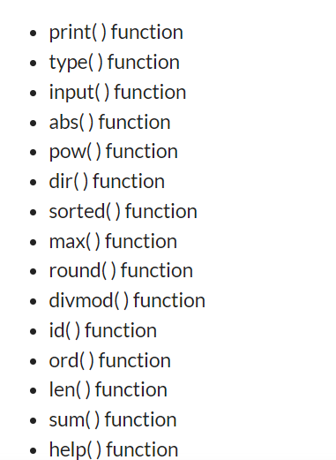
Built – in functions
Python provides a lot of built-in functions that eases the writing of code.

Slide 3
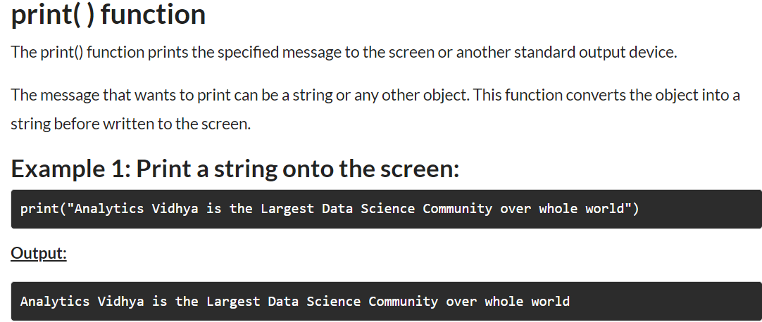
Each function and its definition

Slide 4
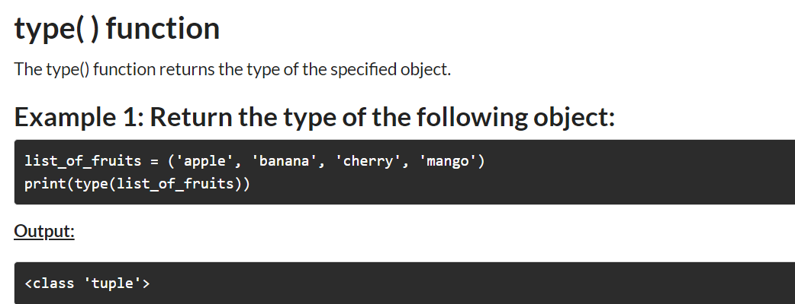
type

Slide 5
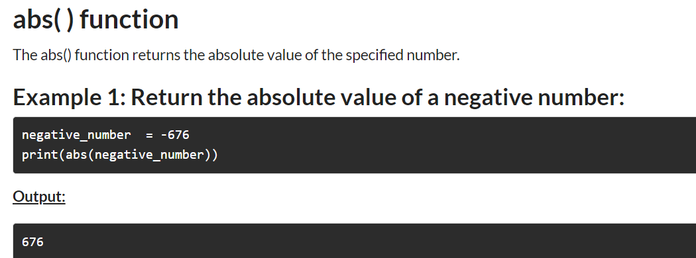
abs

Slide 6
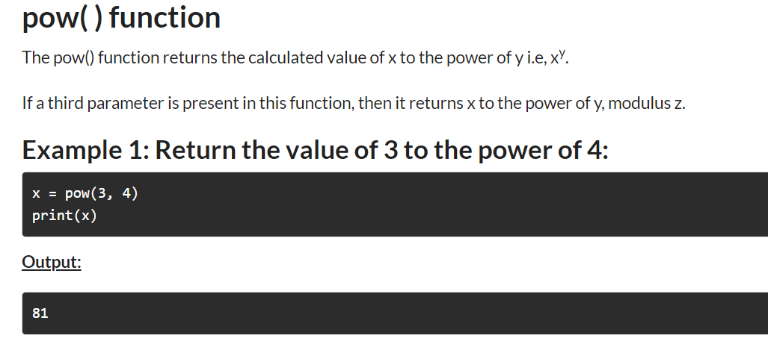
pow

Slide 7
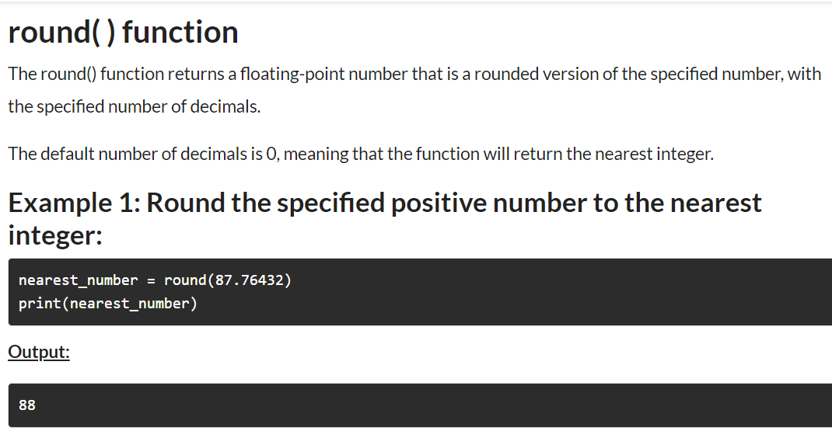
round

Slide 8
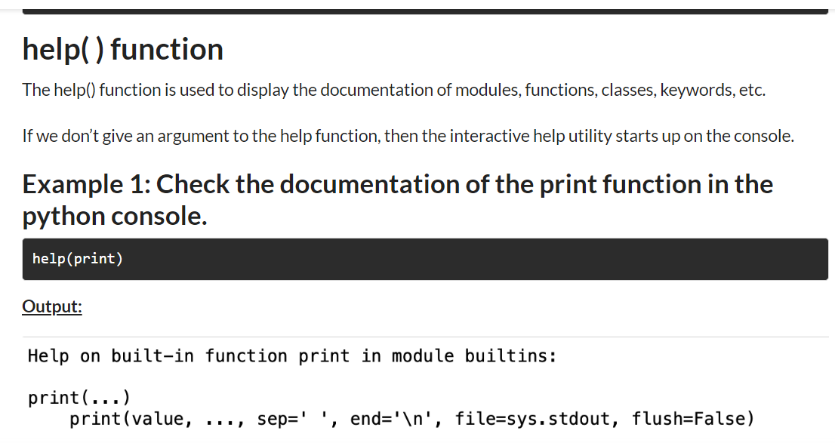
help

Slide 9
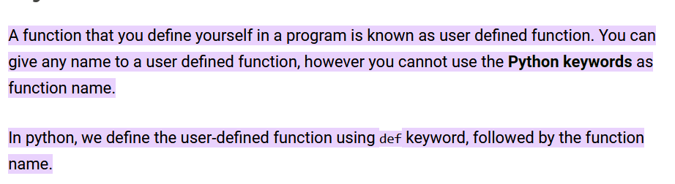
User defined function

Slide 10
Structure of Python program with respect to UDF

Slide 11
Syntax
def name_of_the_function():
  statements
Functions are of 4 types:
  Function without return and without parameter
  Function without return and with parameter
  Function with return and without parameter
  Function with return and with parameter

Slide 12
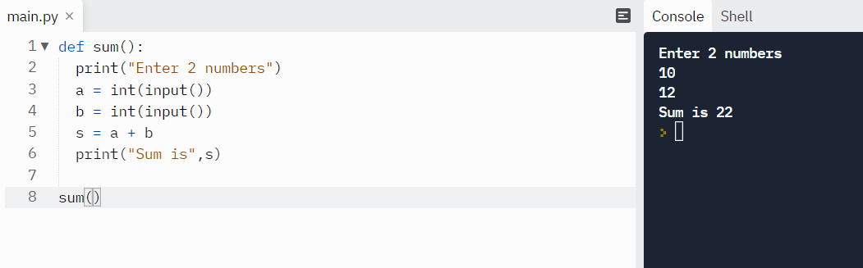
Example – Function without return and without parameter
To add numbers.

Slide 13
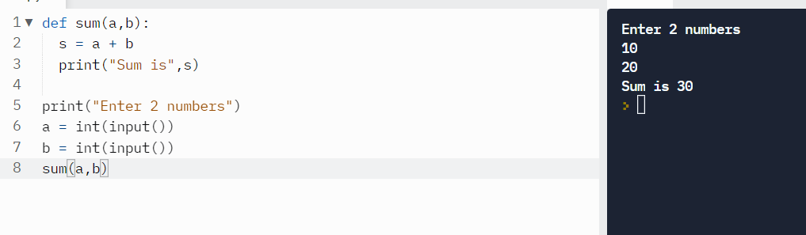
Function with parameter and without return

Slide 14
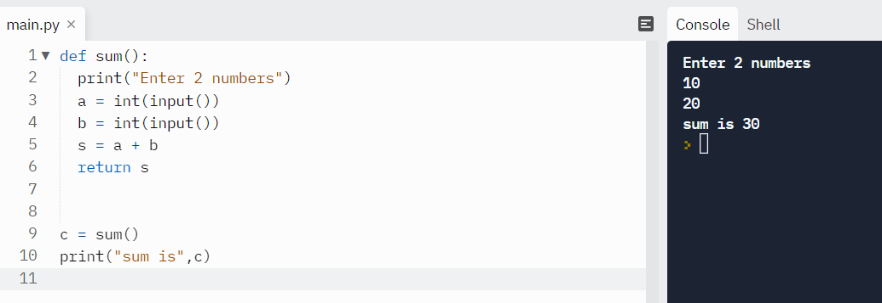
Function without parameter and with return

Slide 15
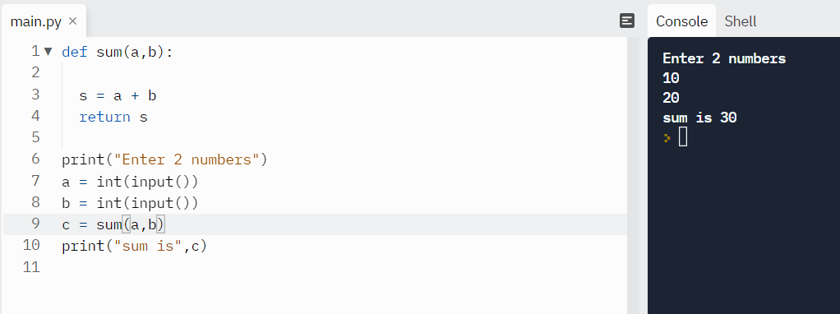
Function with parameter and with return

Slide 16
Question
Write a program showing all arithmetic operator using function.

Slide 17
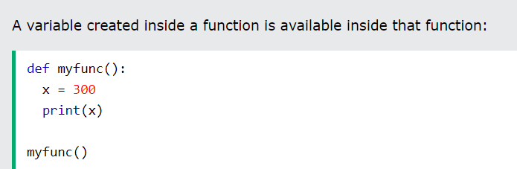
Scope
A variable is only available from inside the region it is created. This is called scope.

Slide 18
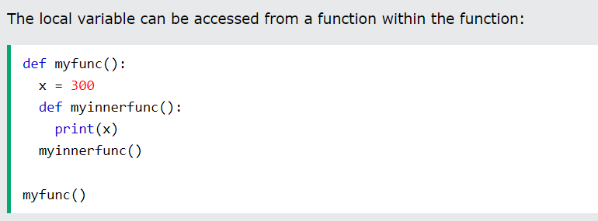
Function inside another function – Local scope

Slide 19
Global Scope
A variable created in the main body of the Python code is a global variable and belongs to the global scope.
Global variables are available from within any scope, global and local.

Slide 20
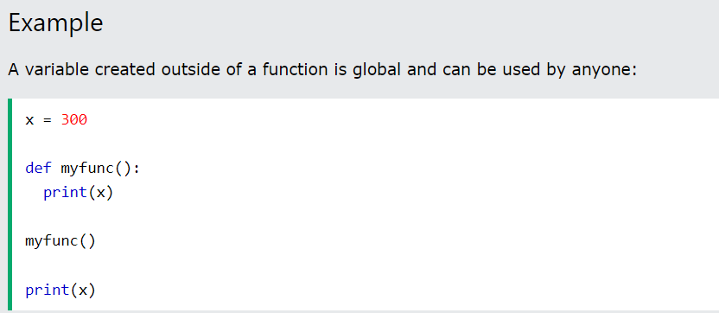
Example

Slide 21
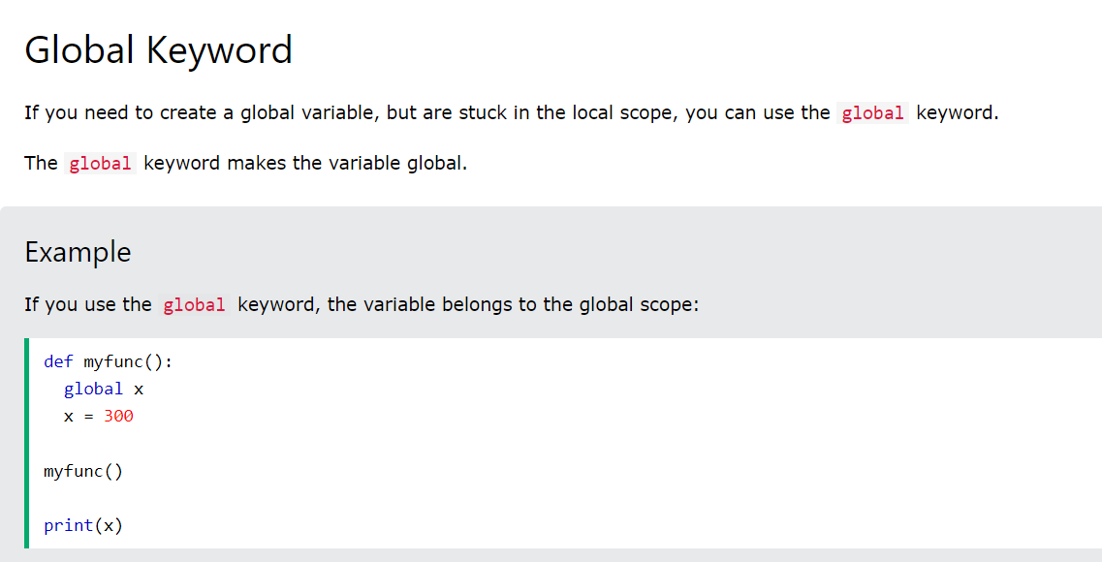
Global Keyword

Slide 22
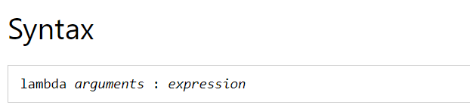
Lambda Function
A lambda function is a small anonymous function.
A lambda function can take any number of arguments, but can only have one expression.

Slide 23
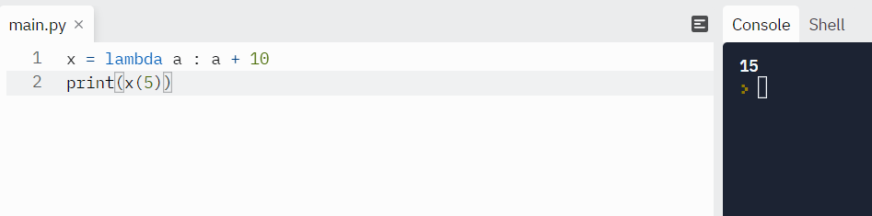
Add 10 to argument a, and return the result:

Slide 24

Multiply argument a with argument b and return the result:

Slide 25
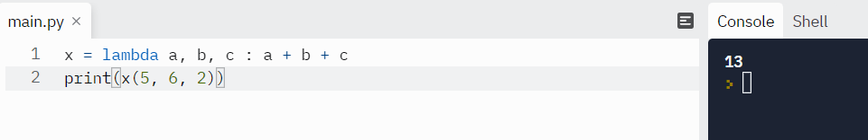
Summarize argument a, b, and c and return the result:

Slide 26
continue
The power of lambda is better shown when you use them as an anonymous function inside another function.
Say you have a function definition that takes one argument, and that argument will be multiplied with an unknown number:

Slide 27
def myfunc(n):
return lambda a : a * n
Use that function definition to make a function that always doubles the number you send in:

Slide 28
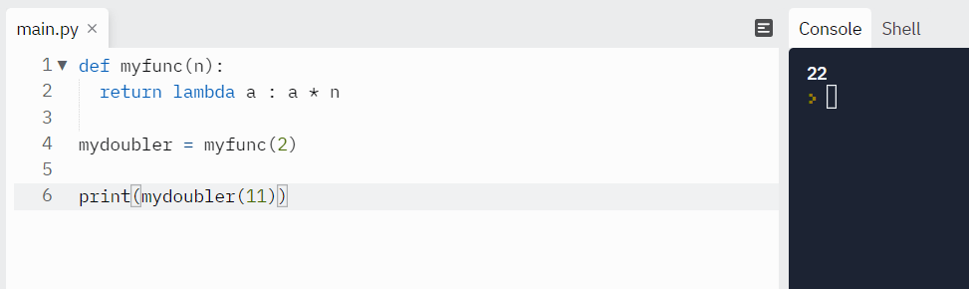

Slide 29
Built – in functions
Python provides a lot of built-in functions that eases the writing of code.

Slide 30
Each function and its definition

Slide 31
type

Slide 32
abs

Slide 33
pow

Slide 34
round

Slide 35
help

Slide 36
User defined function

Slide 37
Structure of Python program with respect to UDF

Slide 38
Syntax
def name_of_the_function():
  statements
Functions are of 4 types:
  Function without return and without parameter
  Function without return and with parameter
  Function with return and without parameter
  Function with return and with parameter

Slide 39
Example – Function without return and without parameter
To add numbers.

Slide 40
Function with parameter and without return

Slide 41
Function without parameter and with return

Slide 42
Function with parameter and with return

Slide 43
Question
Write a program showing all arithmetic operator using function.

Slide 44
Scope
A variable is only available from inside the region it is created. This is called scope.

Slide 45
Function inside another function – Local scope

Slide 46
Global Scope
A variable created in the main body of the Python code is a global variable and belongs to the global scope.
Global variables are available from within any scope, global and local.

Slide 47
Example

Slide 48
Global Keyword

Slide 49
Lambda Function
A lambda function is a small anonymous function.
A lambda function can take any number of arguments, but can only have one expression.

Slide 50
Add 10 to argument a, and return the result:

Slide 51
Multiply argument a with argument b and return the result:

Slide 52
Summarize argument a, b, and c and return the result:

Slide 53
continue
The power of lambda is better shown when you use them as an anonymous function inside another function.
Say you have a function definition that takes one argument, and that argument will be multiplied with an unknown number:

Slide 54
def myfunc(n):
return lambda a : a * n
Use that function definition to make a function that always doubles the number you send in:

Slide 56
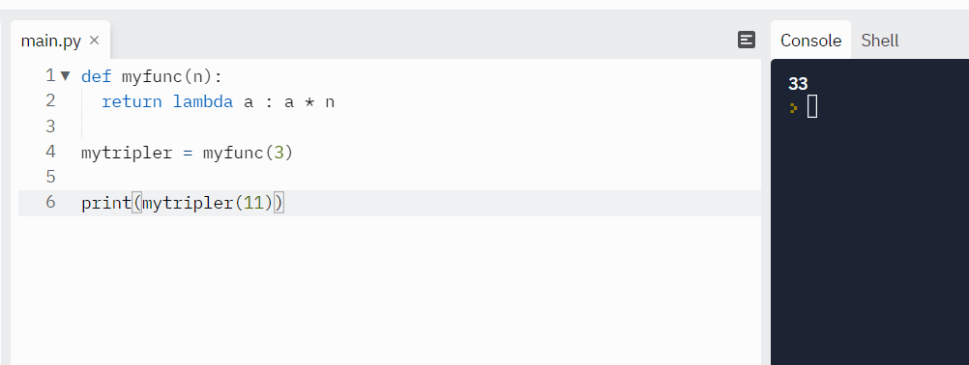
Or, use the same function definition to make a function that always triples the number you send in:

Slide 57
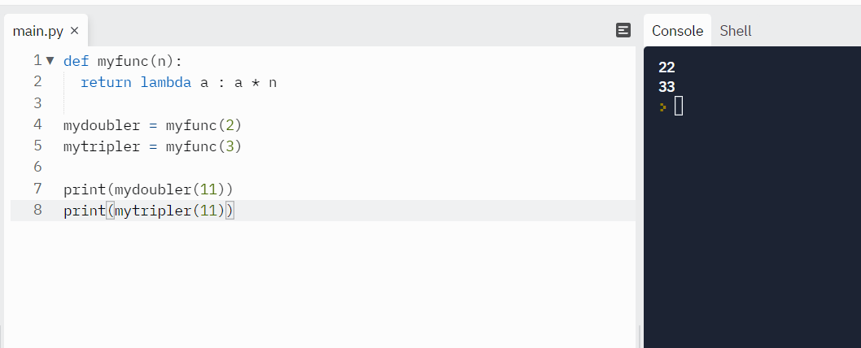
Or, use the same function definition to make both functions, in the same program:

Slide 58
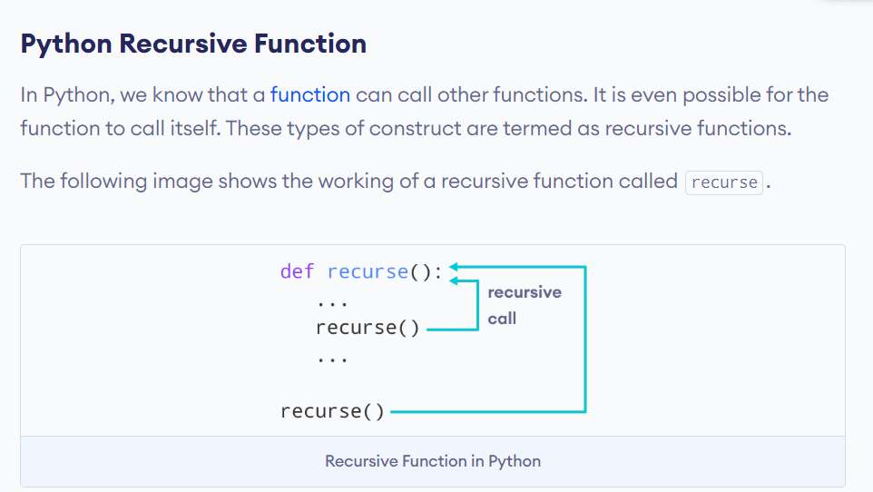
Recursion

Slide 59
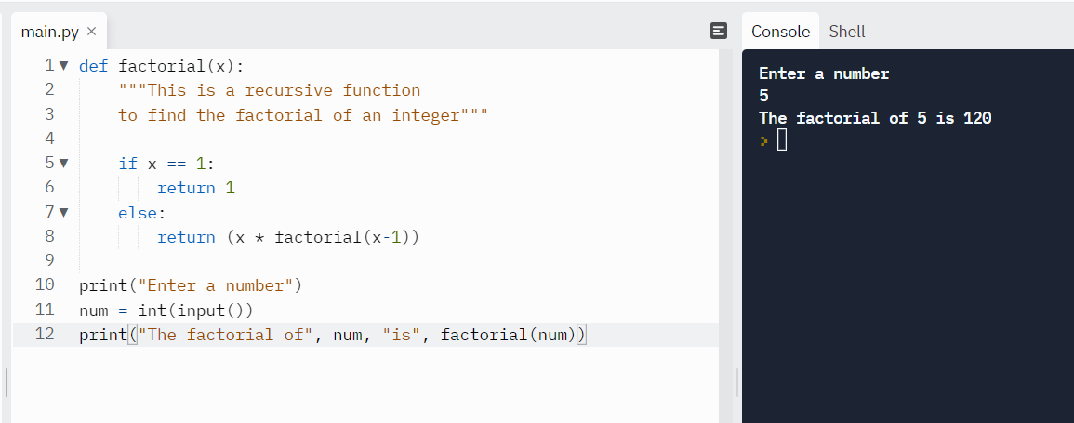
Find factorial of a number.

